Slide 1
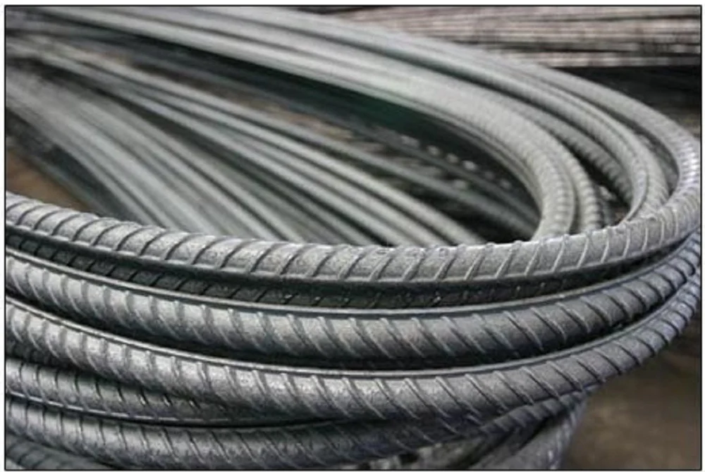
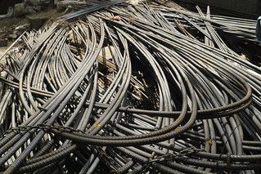
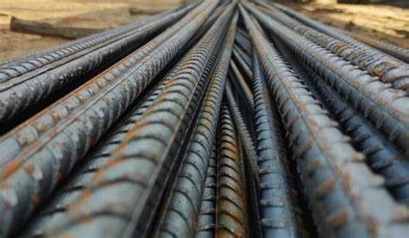

Inventory of steel rod
Summited By : Vaishnav Maurya
Guided By :

Slide 2


Project Leadership
Sharat Manikonda
Director at Innodatatics and Sponsor
linkedin.com/in/sharat-chandra
Bharani Kumar Depuru
Director & Co-Founder at Innodatatics
linkedin.com/in/bharanikumardepuru

Slide 3

Contents
Business objective
Business Constraints
Project Architecture
Data collection and details
Exploratory Data Analysis
Visualization
Notes:
Change

Slide 4

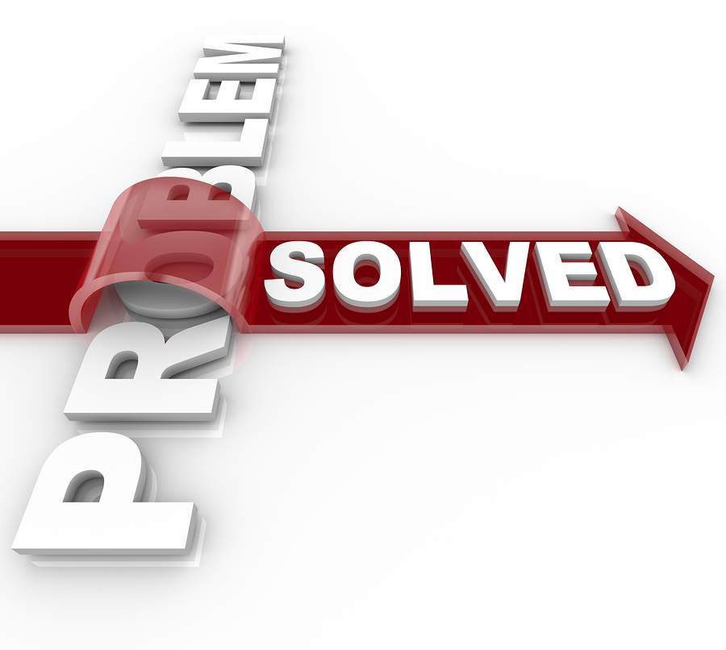
Business Problem
The business in facing a problem of underutilizing the offcuts of steel rods, which are sold as a scrab at a loss of revenue. This inefficient use of resources is negatively impacting the company’s profitability.

Slide 5

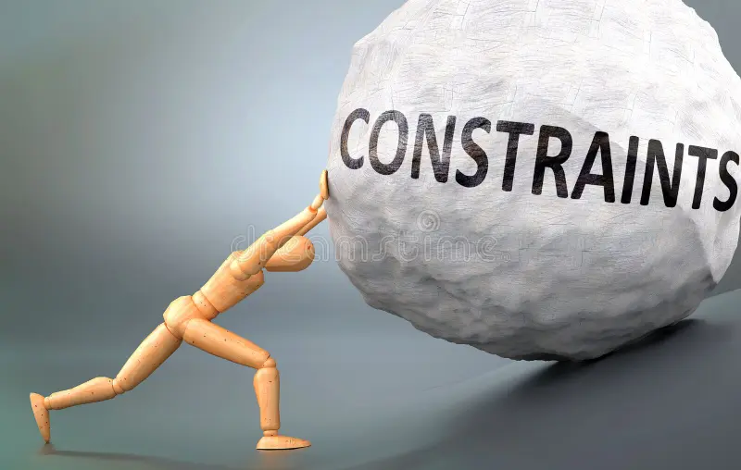
Business Objective
Objective
Constraints
Minimize the underutilization of offcuts rods.
Maximum the profitability
Minimize manual CALCULATION ON USING INVENTORY

Slide 6


Success Criteria
Business Success Criteria
INCREASE OFFCUTS UTILIZATION BY AT LEAST 15%
Economic Success Criteria
Achieve a

Slide 7
1. Business and data understanding 3. Data collection 2. Data Pre-Processing 3. Exploratory Data Analysis 4. Visualization
CRISP-ML(Q) Methodology

Slide 8



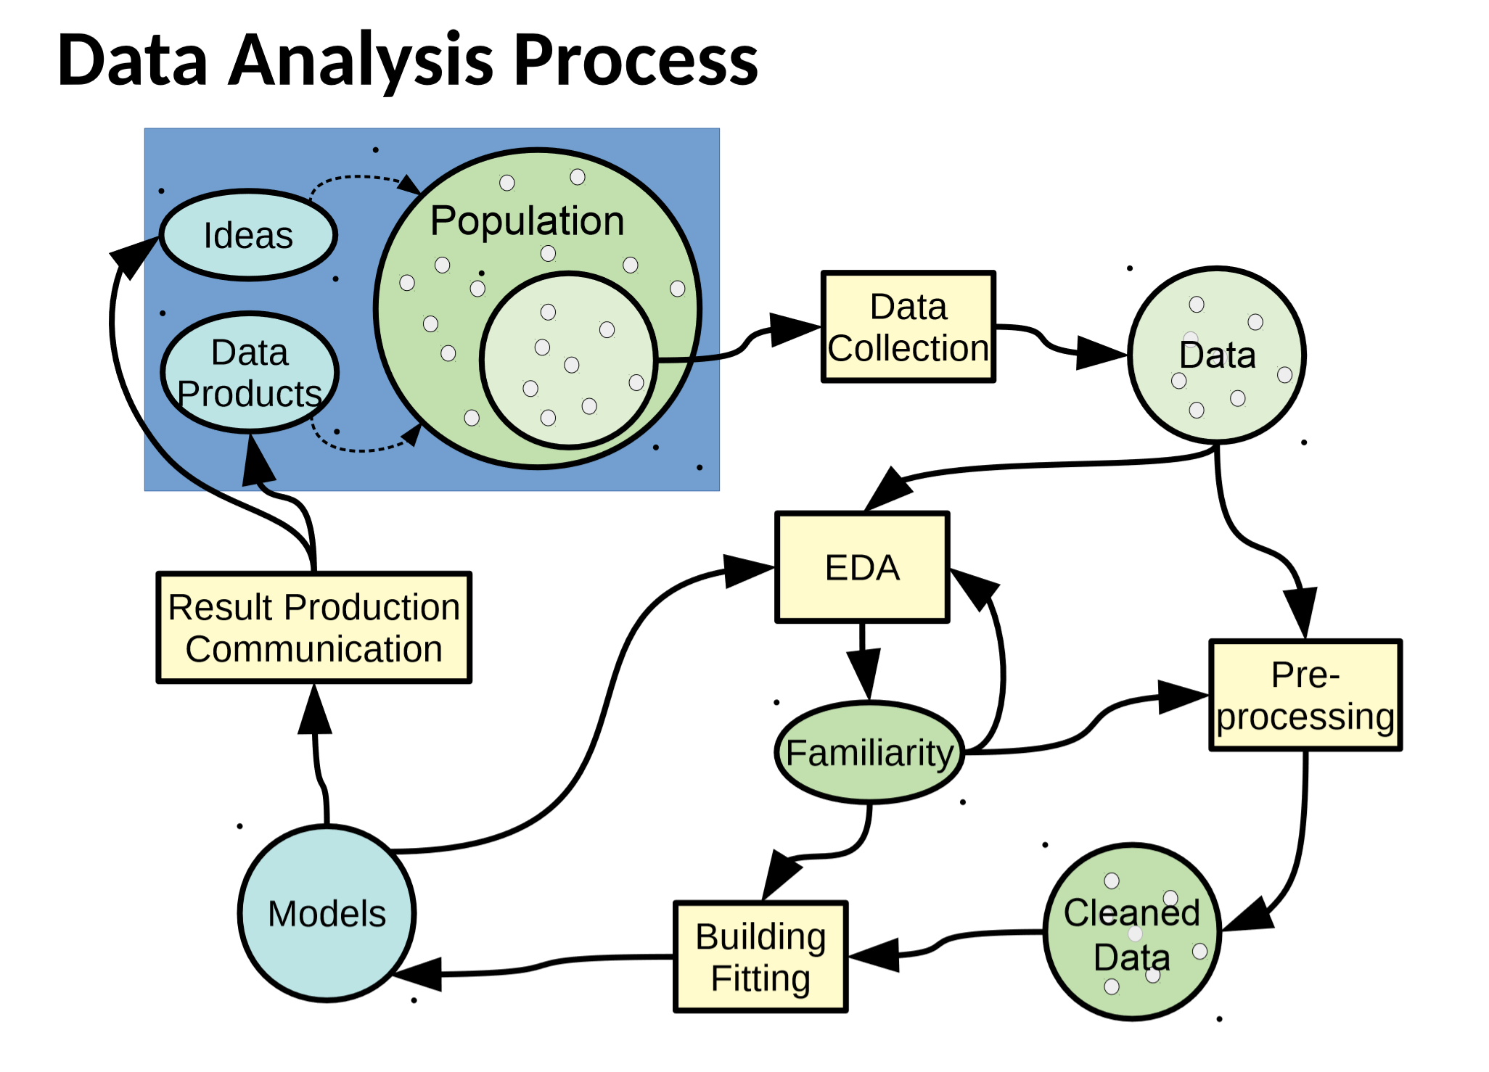

Project Architecture
Data
Mapping
(Python)
Data
Pre-processing
(SQL)
Data
Collection
Business Understanding
Data
Visualization
(Power BI)

Slide 9




Technical Stacks
Python
SQL
Power BI
Excel
Spyder

Slide 10

Data Collection and Understanding
The data were given by client
The given the raw data which contain duplicates, null values and missing values.
The dataset pulled to SQL workbench and python.

Slide 11


Data Information
The data consist of 5504 rows and 29 columns.
1 columns is datetime datatype.
28 columns are of numerical data types.
4 columns have missing values.
5 rows are duplicate rows.

Slide 12
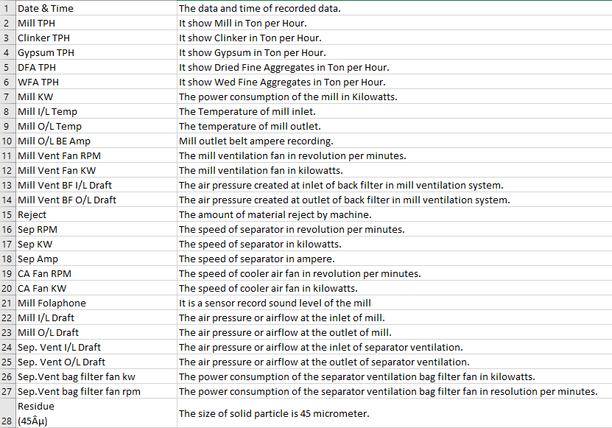
Data Dictionary

Slide 13
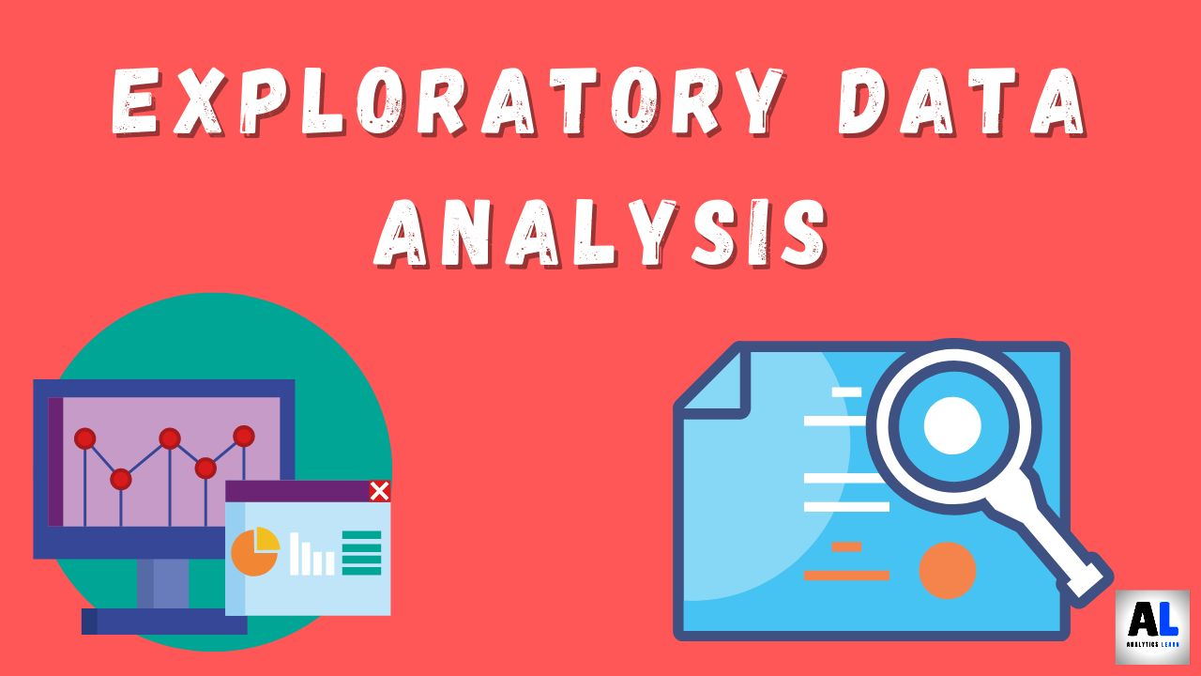
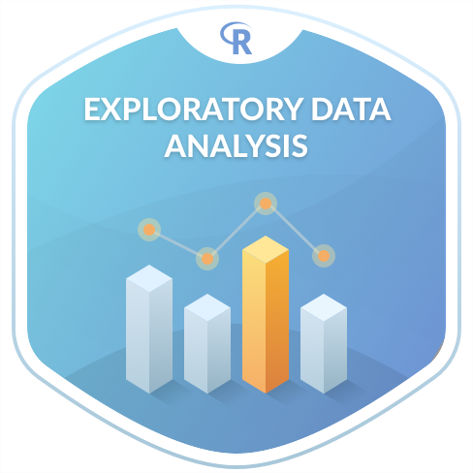

Exploratory Data Analysis [EDA]
Exploratory Data Analysis (EDA) is a process in data analysis where we explore and analyze data to understand its main characteristics, patterns and relationship.
It involve technique such as data visualization, summary statistics and data cleaning.
The primary goal of EDA is to uncover the underlying structure and relationship within the data, as well as to discover any interesting patterns or trends that may exist.
Exploratory Data Analysis (EDA) is an analysis approach that identifies general patterns in the data. These patterns include outliers and features of the data that might be unexpected.
Notes:
EDA is used for seeing what the data can tell us before the modeling task.
Change

Slide 14

Missing Values Observation
Missing Values:-
WFA TPH – It have 1 missing value. Mean get influence by outlier so for missing value we used median imputation.
Mill Vent BF O/L Draft – It have 1 missing value. Mean get influence by outlier so for missing value we used median imputation.
Separator KW – It have 1 missing value. Mean get influence by outlier so for missing value we used median imputation.
Separator Vent bag filter fan rpm – It have 1 missing value. Mean get influence by outlier so for missing value we used median imputation.

Slide 15

Data Preprocessing
Data Cleaning:-
Handling duplicates - There are total 5 duplicates. In this process we remove the duplicates.
Outlier Treatment – The present of outlier can significantly impact the analysis. Outlier can skew the result and effect the interpretation of the data. It’s important to treat the outlier to insure the accurate and reliable anallllysis. In this dataset some columns have very less outlier and some have outlier more than 10 %. The columns have outlier more than 10% and column name ‘Residue’ are retain and outlier treatment(Winsorization capping method IQR) is performed to the columns have less than 10% of outlier. The some outlier analysis are as follow:
3R Technique: Rectify, Retain, Remove
Winsorization
Trimming
Notes:
Keep observations

Slide 16
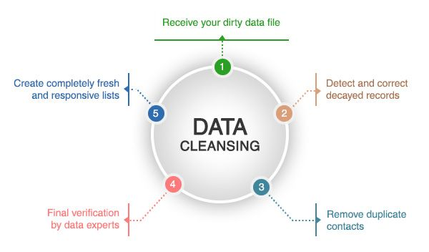

Data Preprocessing
Missing Value – It may lead to biased or incomplete analysis. The missing value can affect the accuracy and reliability of the results obtained from the data. It is important to handle missing values to ensure the integrity of the analysis.
Transformation – Data transformation involves modifying the original data to make it more suitable for analysis or modeling purposes. It is used to address issues such as non-normality or non-linear relationships in the data. B u applying transformations like log, exponential, power and box cox transformations, we can improve the distribution, reduces skewness and make the data more amenable to statistical analysis.
Feature Scaling – It is a technique used to standardize and normalized range of feature or variable in a dataset. It ensure that all feature are on similar scale. Common method of feature scaling standardization and normalization. Standardization means subtracting the mean and dividing by the standard deviation and Normalization means scaling values between 0 and 1.

Slide 17
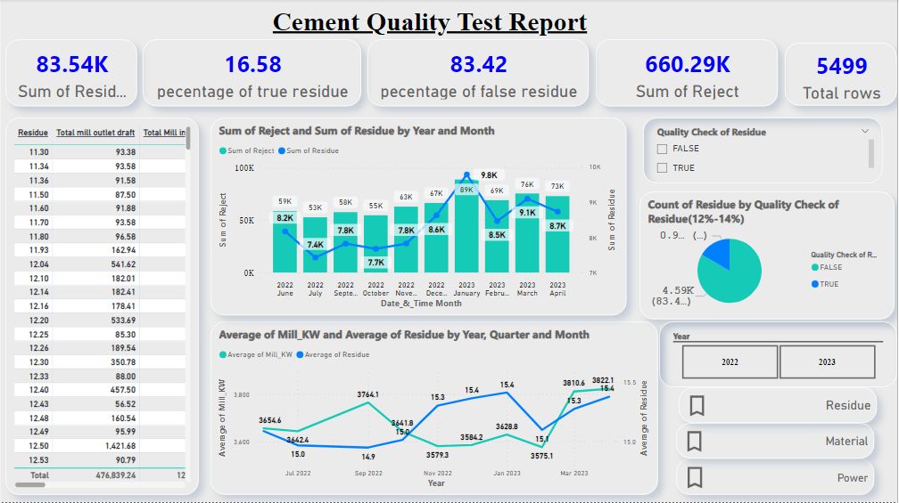
Data Visualization
Residue
Notes:
Add graphical

Slide 18
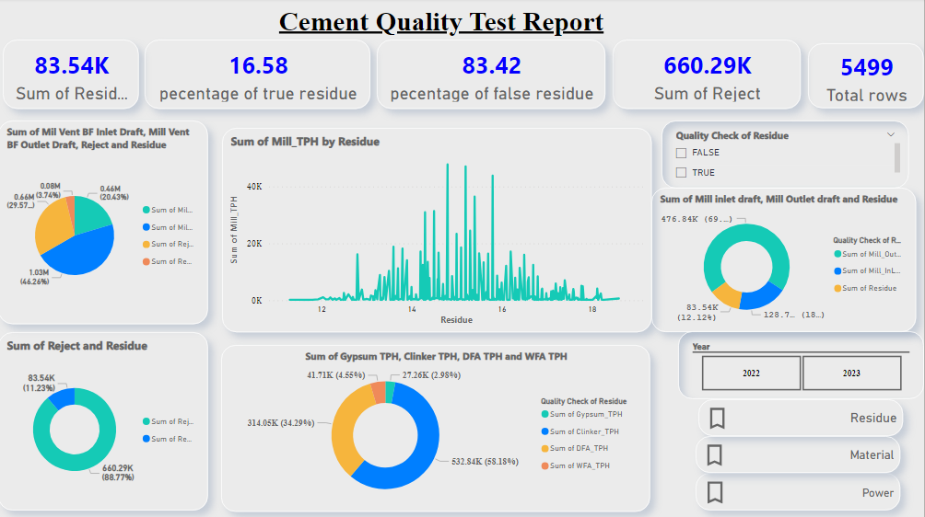
Data Visualization
Material

Slide 19
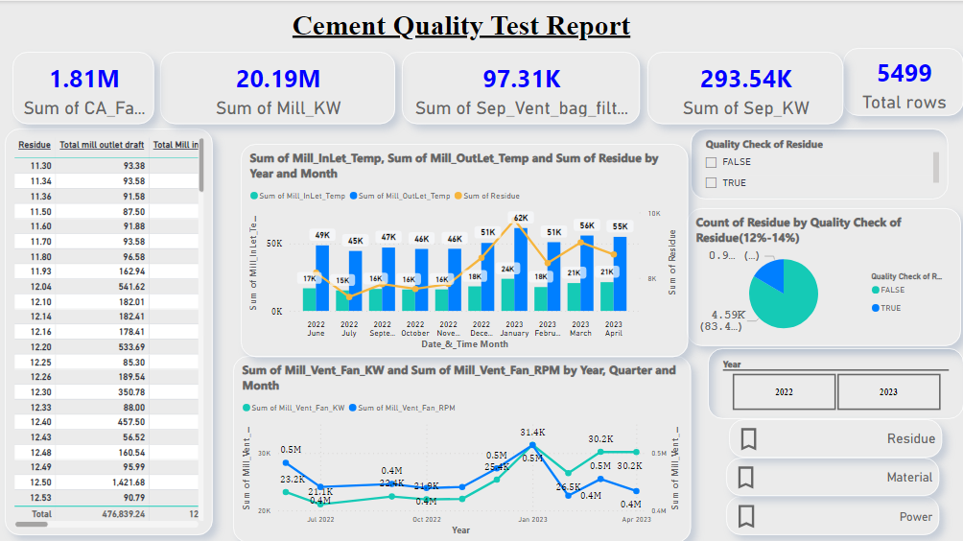
Data Visualization
Power

Slide 20


Challenges
Challenges I Face in: -
In handling missing values in SQL workbench. I found difficulty in median imputation. The query is showing errors.
In finding the outlier, I am not able to detect the outlier using IQR approach in MySQL workbench, so here I identify outlier using standard deviation approach, any value which fall below ‘mean + 3σ’ and above ‘mean + 3σ’ would be treated as outlier.
In importing dataset from excel to postgres SQL.
In treatment of outlier after performing outlier treatment then also some columns have outliers.
In data transformation, after performing box cox transformation some columns still non-normal.
In Auto EDA auto-viz and pandas profiling, I face some difficulties regarding lack of memory but after some clearing memory I able to run the code but then page is continuously showing Refresh the page.

Slide 21


Future Scopes
The future scope of Cement Manufacturing Automation quality check depend on various factor such as chemical composition, fineness, setting time and durability. The scope encompasses everything from chemical composition and physical properties of the cement to its performance and durability in different applications. The direction is to continuously improve and innovate in order to produce high-quality cement.

Slide 22

Queries ?

Slide 23


